Slide 1

CSE4037
REINFORCEMENT LEARNING
SEMI MDP MODEL

Slide 2
Module No. 6
Hierarchical Reinforcement Learning
8 Hours
Hierarchical Reinforcement Learning
Types of Optimality
Semi MDP Model
Options
Learning with Options
Hierarchical Abstract Machines
A partially observable Markov decision process.

Slide 3
Markov Decision Process
Markov Decision Process (MDP) is a mathematical formulation of decision making. An agent is the decision maker. In the reinforcement learning framework, he is the learner or the decision maker.
We need to give this agent information so that it is able to learn to decide. As such, an MDP is a tuple: ⟨𝑆,𝐴,𝑃,𝛾,𝑅⟩ that is (State, Action, Probability Transitions, discount factor, Reward).
It is basically all you need to know about the problem to be able to make a good decision to optimally perform a task.

Slide 4
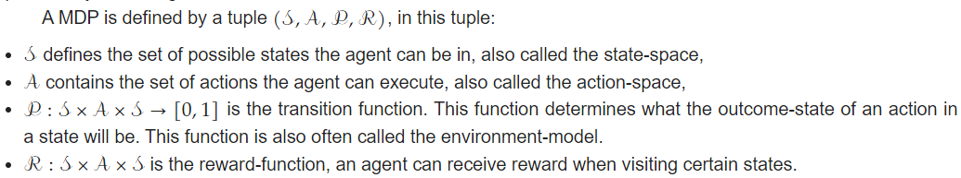
Markov Decision Process
A Markov Decision Process (MDP) is a formal model, used to describe discrete-time stochastic control processes. The MDP model is useful for representing decision-making problems in which an agent can influence the process by executing actions.

Slide 5
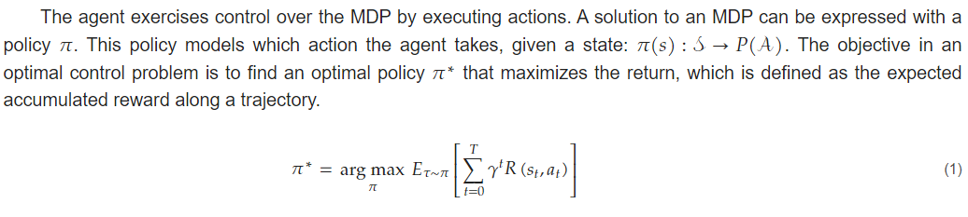
Markov Decision Process

Slide 6
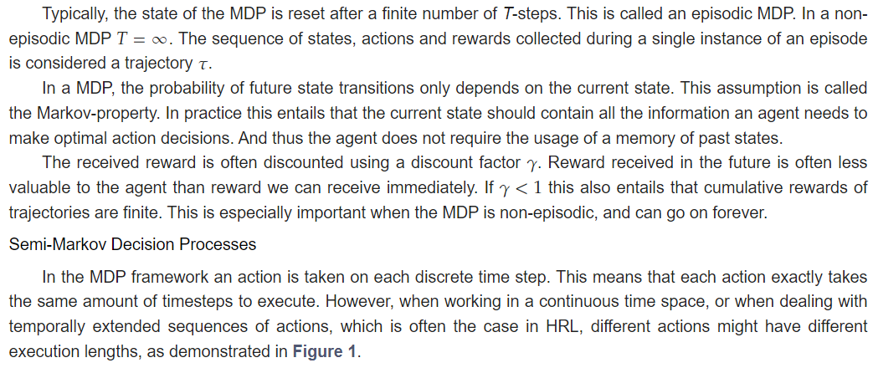
Markov Decision Process

Slide 7
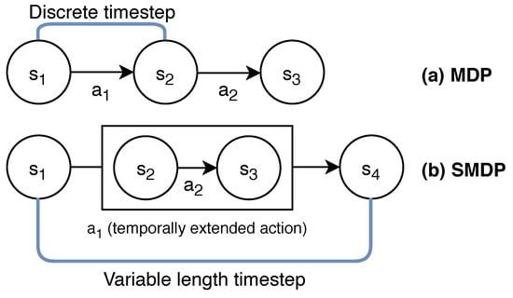
MDP Vs SMDP
The MDP framework differs from an SMDP, in that an SMDP allows the length between timesteps to be variable. This is an essential property to support temporally extended actions.

Slide 8
Semi-Markov Decision Process
In order to support variable duration of a single action, the MDP framework has been extended to the Semi-Markov Decision Process (SMDP) framework

Slide 9
Semi-Markov Decision Processes
It is a semi-MDP because the process is Markovian at the level of decision points/epochs (at the level of the decisions over options) but not at the "flat" level. That is, if you don't observe the current choice of options along the trajectories and only see state-action pairs, that process won't be Markovian.
Semi-MDPs are thus used to deal with such problems that involve actions of different levels of abstraction. Hierarchical reinforcement learning (HRL) is a generalization (or extension) of reinforcement learning where the environment is modeled as a semi-MDP.

